Slide 1
HFEA Analysis year 2015-16

Slide 2
About data
In this data the patient records are 80488 records
Out of this data the missing values are 1% so, values are deleted
After dropping null values in data there are 76322 records are remained
The most techniques used in this data are IVF & ICSI

Slide 3
Variable names
S.no | Name of the variable |  | S.no | Name of the variable
1 | Patient_Age_at_Treatment |  | 14 | Fresh_Eggs_Collected
2 | Total_Number_of_Previous_treatments_Both_IVF_and_DI_at_clinic |  | 15 | Fresh_Eggs_Stored
3 | Total_Number_of_Previous_IVF_cycles |  | 16 | Total_Eggs_Mixed
4 | Total_number_of_previous_pregnancies_Both_IVF_and_DI |  | 17 | Eggs_Mixed_With_Partner_Sperm
5 | Total_number_of_IVF_pregnancies |  | 18 | Eggs_Mixed_With_Donor_sperm
6 | Donated_embryo |  | 19 | Total_Embryos_Created
7 | Specific_treatment_type |  | 20 | Eggs_Microinjected
8 | Elective_Single_Embryo_Transfer |  | 21 | Embryos_from_Eggs_Microinjected
9 | Egg_Source |  | 22 | Total_Embryos_Thawed
10 | Sperm_From |  | 23 | Embryos_Transfered
11 | Fresh_Cycle |  | 24 | Embryos_Transfered_from_Eggs_Microinjected
12 | Eggs_Thawed |  | 25 | Embryos_Stored_For_Use_By_Patient
13 | Fresh_Eggs_Collected |  | 26 | Number_of_Live_Births

Slide 4
Target column
The problem statement of this data is “Number of live births in the year 2015 - 2016” with the range 0,1,2
Since this data is having less number of records twin(2) live births so, the data with 2 live births are removed so now data is binary
In this data non live births 56599 , for first checking the quality the data is down-sampled and brought into 19723 both live and non live birth and performed analysis
imbalanced data also send into models and checked with feature importance's and without feature importance’s.

Slide 5
Statistical analysis Chi-square test
It is based on the bivariate analysis and used for both the columns are categorical.
After performing chi-square test only probability less than 0.05 (5%) considered for analysis.
Since target column is binary data so correlation is not performed

Slide 6
Annova
It is also one of the bivariate analysis technique and it performs statistical analysis with continuous and categorical data
In this annova only probability less than 0.05(5%) is taken into consideration and performed the analysis which it is known as null hypothesis

Slide 7
After chi-square test
Total_Embryos_Thawed
Embryos_Transfered_from_Eggs_Microinjected
Embryos_Transfered
Fresh_Eggs_Collected
Fresh_Eggs_Stored
Total_Embryos_Created
Total_Number_of_Previous_IVF_cycles
Eggs_Mixed_With_Donor_sperm

Slide 8
After annova
Total_Eggs_Mixed
Embryos_Transfered
Fresh_Eggs_Stored
Total_Number_of_Previous_treatments_Both_IVF_and_DI_at_clinic
Embryos_Transfered_from_Eggs_Microinjected
Eggs_Thawed
Fresh_Eggs_Collected
Total_Embryos_Thawed
Embryos_from_Eggs_Microinjected
Total_Embryos_Created
Total_Number_of_Previous_IVF_cycles

Slide 9
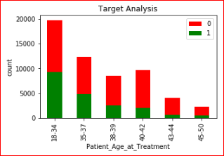
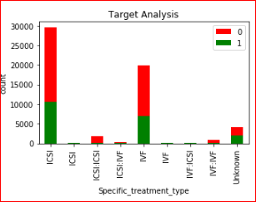
Graphs & insights
In the above graph the age group of people 18-34 and 35-37 has more successful live births
ICSI and IVF in the year 2015-16 there is success of 30% and 28% respectively

Slide 10
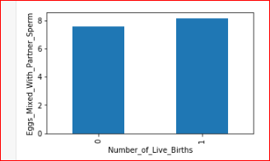
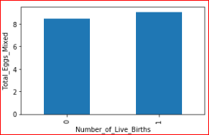
Graphs & insights
In imbalanced the success of having live birth is on an average more than 8 eggs mixed with partner sperm
Average 8 eggs are needed to get a live birth chances with all the techniques

Slide 11
Models Applied
Logistic regression
Multinomial Naïve Bayes
XG Boost
Random Forest
Decision Tree

Slide 12
Accuracy of models
IMBALANCED | XG BOOST | DECISIONTREE | LINEAR REGRESSION | MULTINOMIAL NB | RANDOMFOREST
without feature selection | 74% | 69% | 73% | 70% | 65%
with feature selection | 74% | 62% | 73% | 72% | 63%
BALANCED | XG BOOST | DECISIONTREE | LINEAR REGRESSION | MULTINOMIAL NB | RANDOMFOREST
without feature selection | 68% | 55% | 65% | 60% | 57%
with feature selection | 68% | 62% | 62% | 62% | 63%

Slide 13
K-FOLD cross validation
In K-Folds Cross Validation we split our data into k different subsets (or folds). We use k-1 subsets to train our data and leave the last subset (or the last fold) as test data. We then average the model against each of the folds and then finalize our model. After that we test it against the test set.

Slide 14
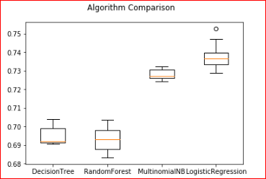
Graphs of k-fold

Slide 15
conclusion
Out of all models LOGISTIC REGRESSION shown more accuracy 73% and an ensemble technique XG BOOST performed with 74% accuracy here we have less number of false negatives are there so model is predicting good
Confusion matrix of LOGISTIC REGRESSION & XG BOOST
TP - 16534 FP – 5704 TP - 16863 FP - 66
TN- 264 FN - 264 FN - 5917 TN - 51

